Slide 1
Introduction to Neural Networks

Slide 2
What is neural network?
An attempt to process information using artificial neurons in a way similar to biological neural system does.
An interconnected group of artificial neurons that uses mathematical model to solve the given problem.
Can be used
To model complex relationships between input and output
To identify patterns in the data
Applications
Pattern recognition – radar systems, face identification, object recognition
Sequence recognition – speech recognition, gesture recognition, handwritten text recognition
Vehicle control, process control, medical diagnosis, financial & business predictions, fraud & email spam detection

Slide 3
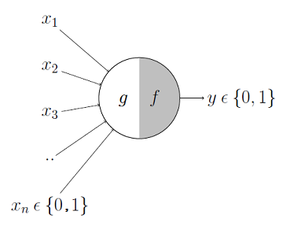
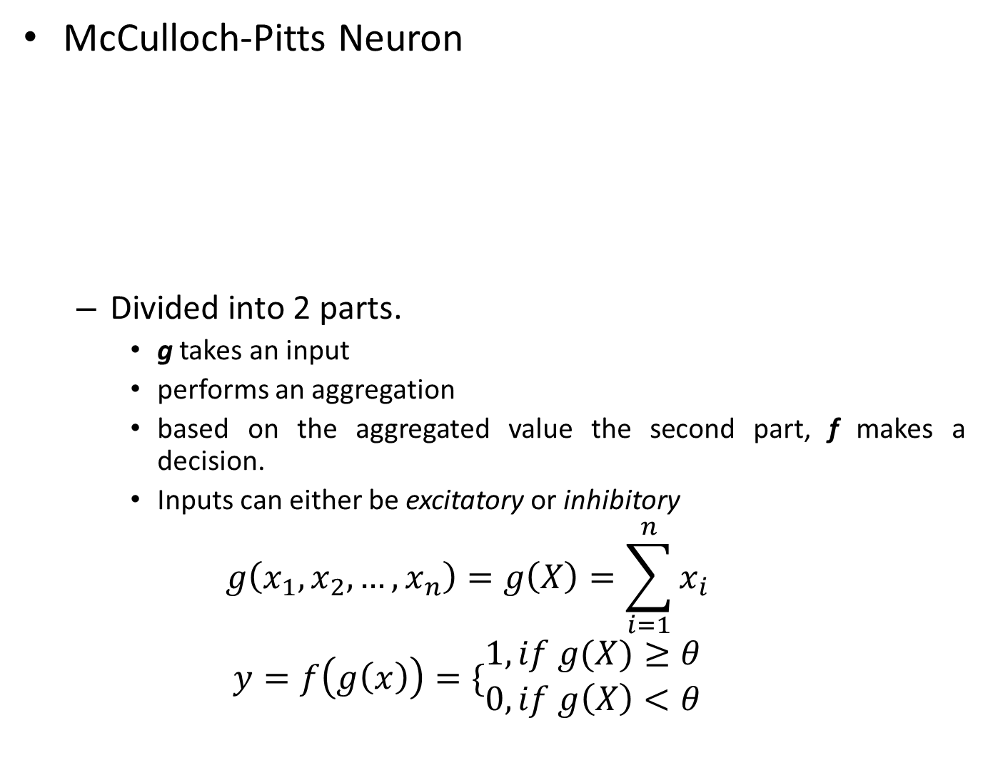
McCulloch-Pitts Neuron
Divided into 2 parts.
g takes an input
performs an aggregation
based on the aggregated value the second part, f makes a decision.
Inputs can either be excitatory or inhibitory
$$g\left(x_{1},x_{2},…,x_{n}\right)=g\left(X\right)=\sum_{i=1}^{n}{x_{i}}$$
$$y=f\left(g\left(x\right)\right)=\{\begin{matrix}1, if g(X)≥θ \\ 0, if g\left(X\right)<θ\end{matrix}$$

Slide 4
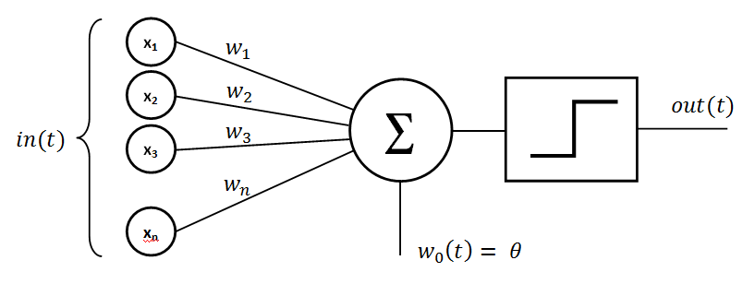

Perceptron
$$g\left(X\right)=b+w_{1}x_{1}+w_{2}x_{2}+…+w_{n}x_{n}=b+W⋅X$$
$$y=f\left(g\left(X\right)\right)=\{\begin{matrix}1, if g\left(X\right)≥0 \\ 0, otherwise\end{matrix}$$
Can be used for binary classification if the data is linearly separable
g(X)
f(g(X))
y
b = -Θ

Slide 5
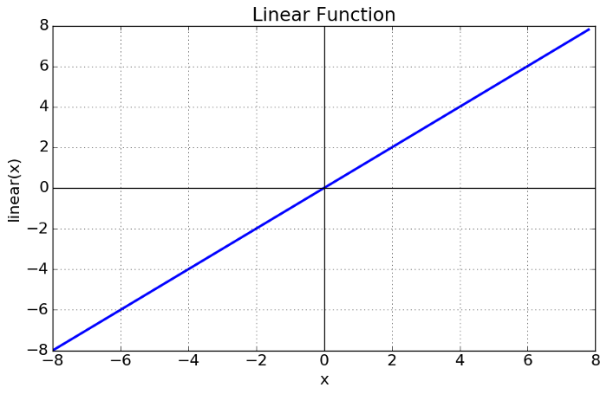
Activation functions
Used to decide if a neuron will be fired (activated) or not & if activated then what will be output from it.
Mainly two types
Linear
Non-linear
Linear/Identity activation function
f(x)=x
Range=(-inf) to (+inf)
Not really useful

Slide 6
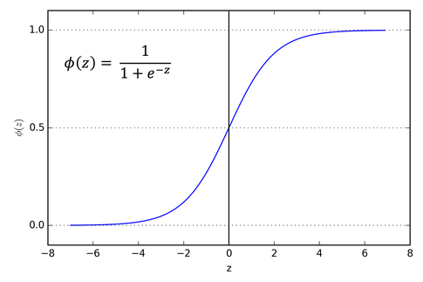
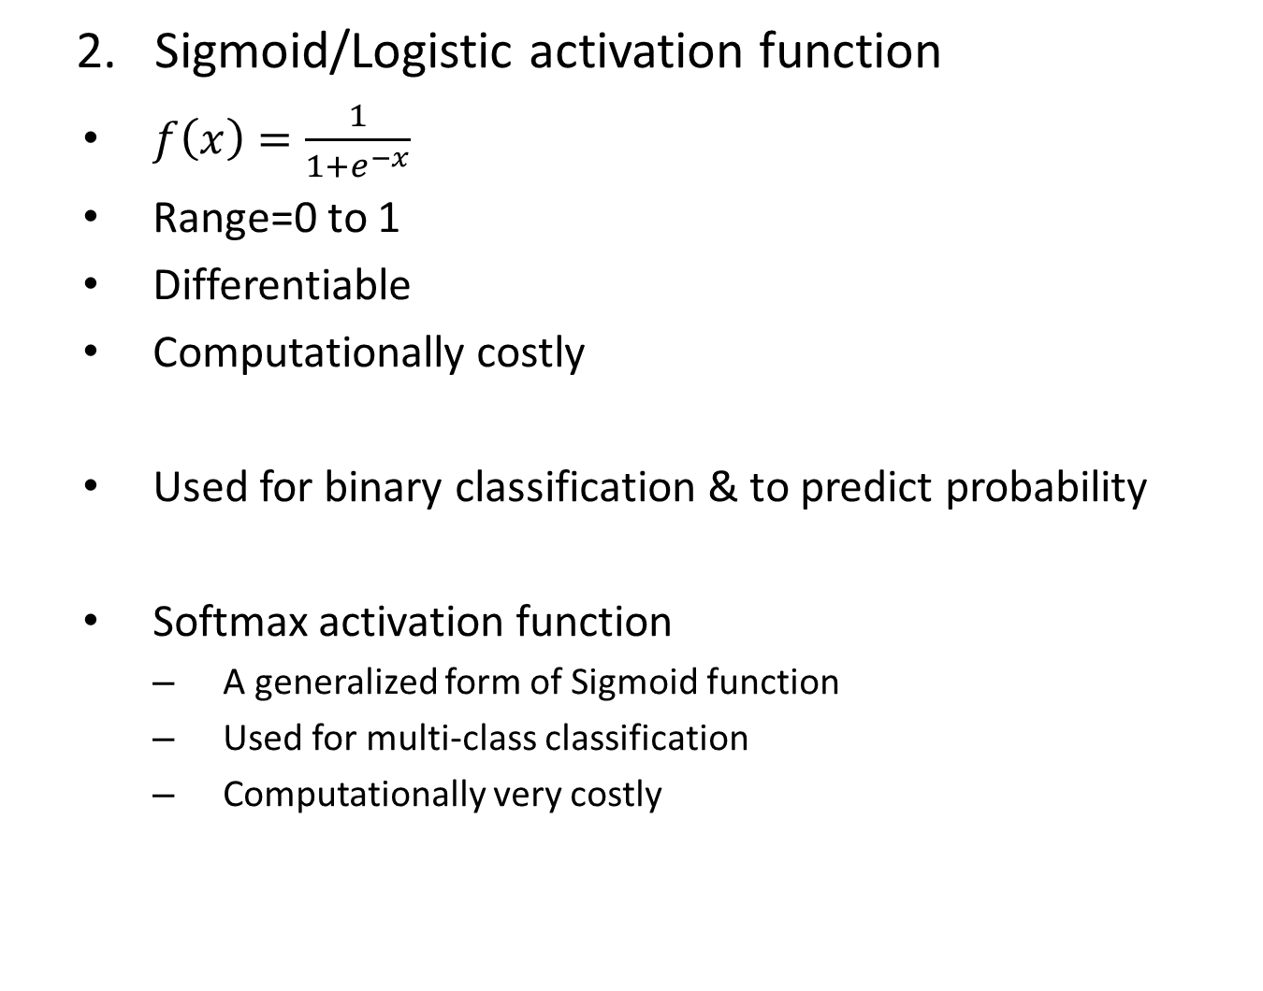
Sigmoid/Logistic activation function
$f\left(x\right)=\frac{1}{1+e^{−x}}$
Range=0 to 1
Differentiable
Computationally costly
Used for binary classification & to predict probability
Softmax activation function
A generalized form of Sigmoid function
Used for multi-class classification
Computationally very costly

Slide 7
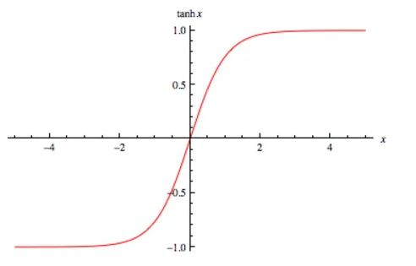
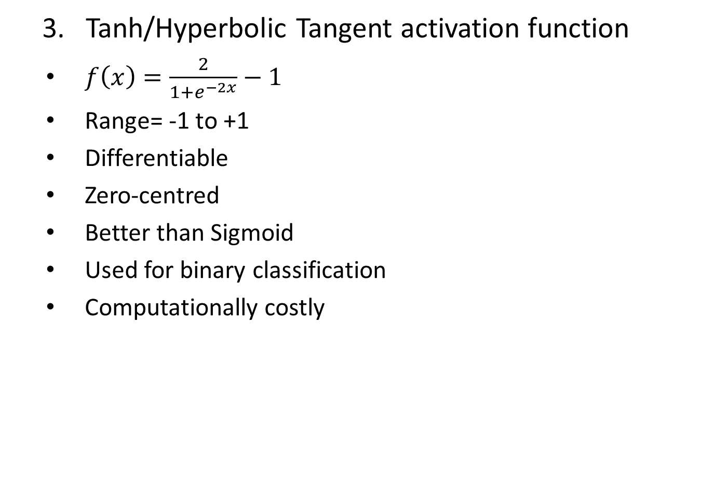
Tanh/Hyperbolic Tangent activation function
$f\left(x\right)=\frac{2}{1+e^{−2x}}−1$
Range= -1 to +1
Differentiable
Zero-centred
Better than Sigmoid
Used for binary classification
Computationally costly

Slide 8
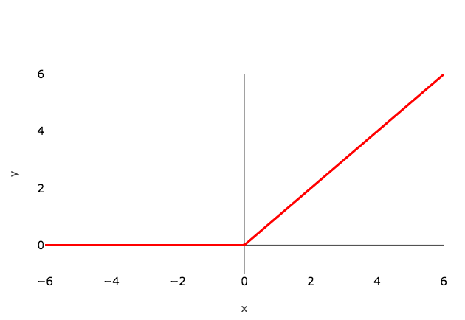
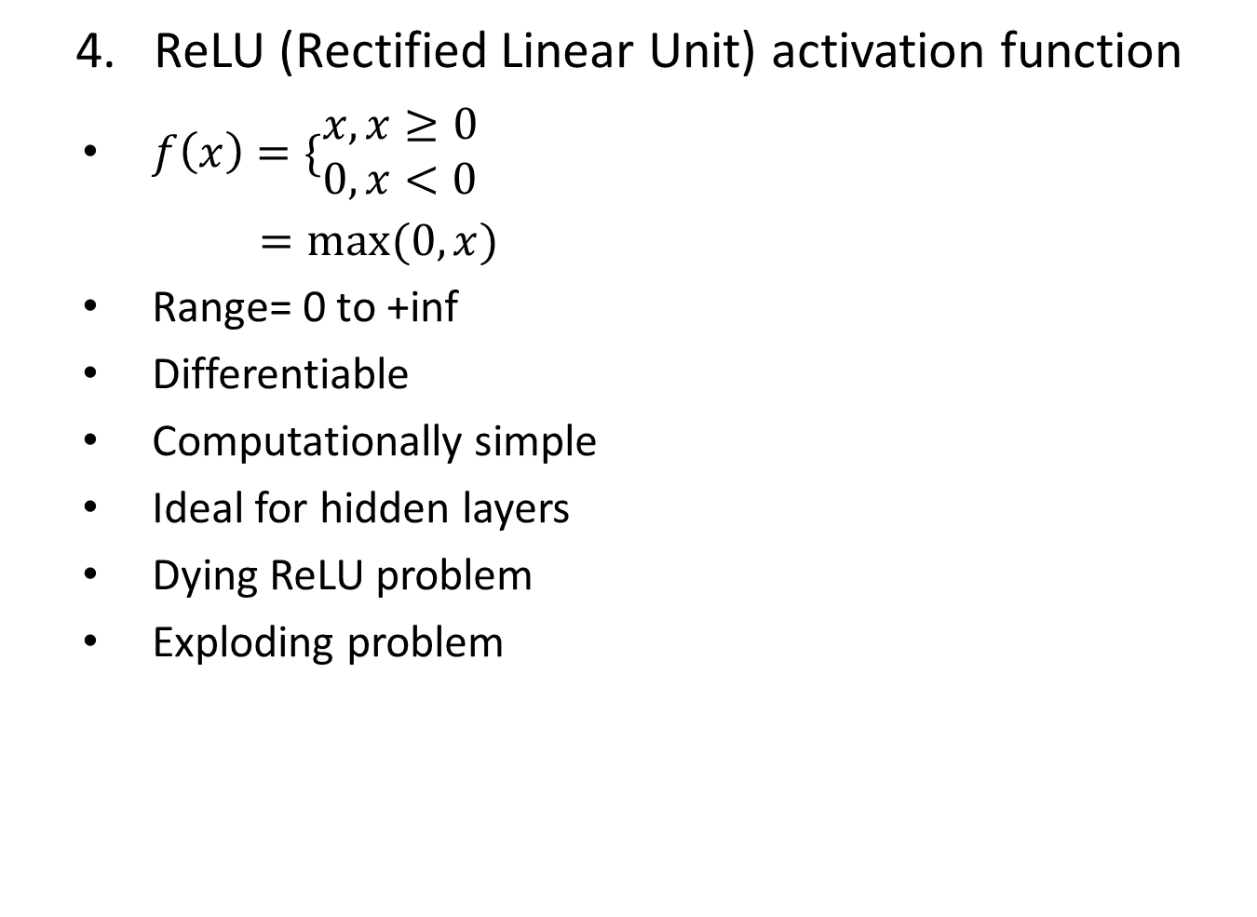
ReLU (Rectified Linear Unit) activation function
$f\left(x\right)=\{\begin{matrix}x, x≥0 \\ 0,x<0\end{matrix}$
$=max⁡(0,x)$
Range= 0 to +inf
Differentiable
Computationally simple
Ideal for hidden layers
Dying ReLU problem
Exploding problem

Slide 9
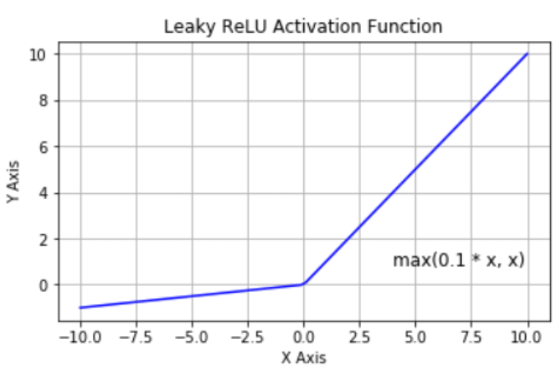
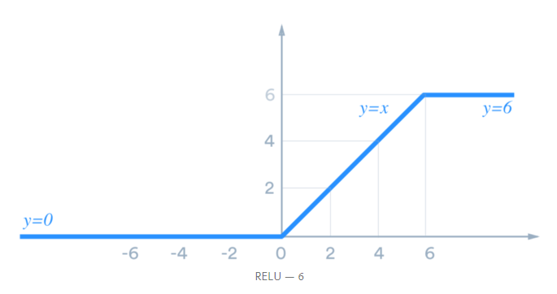
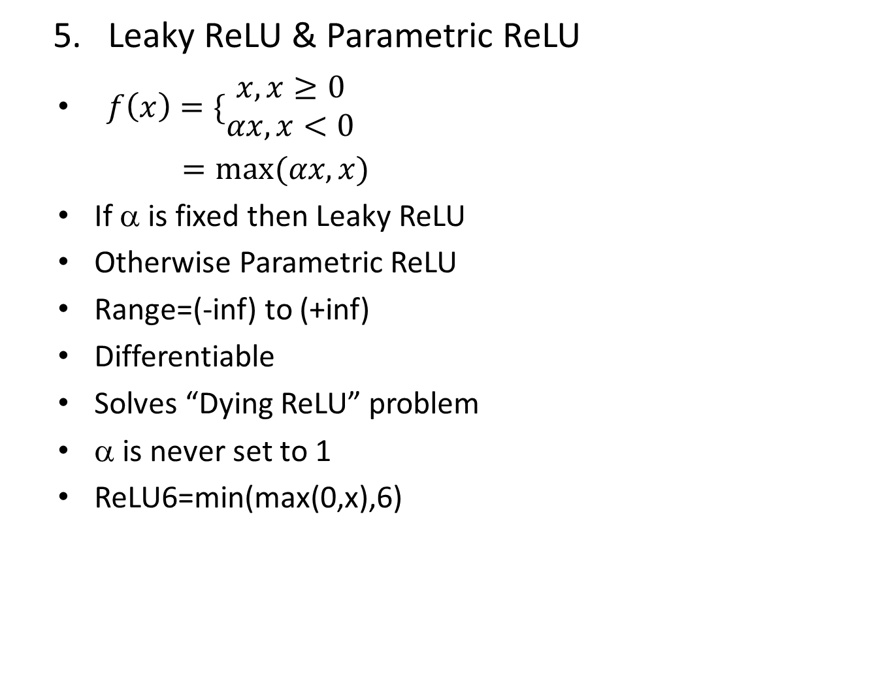
Leaky ReLU & Parametric ReLU
$f\left(x\right)=\{\begin{matrix}x,x≥0 \\ αx,x<0\end{matrix}$
$=max⁡(αx,x)$
If α is fixed then Leaky ReLU
Otherwise Parametric ReLU
Range=(-inf) to (+inf)
Differentiable
Solves “Dying ReLU” problem
α is never set to 1
ReLU6=min(max(0,x),6)

Slide 10
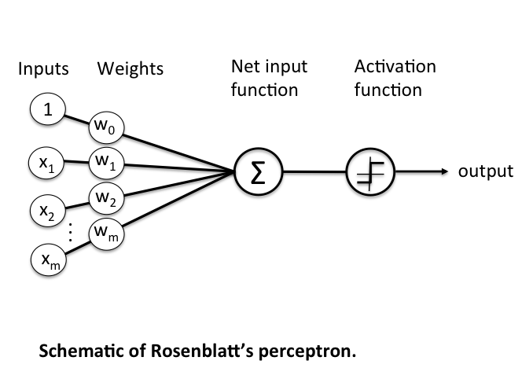
Two desirable properties of activation functions
Nonlinearity
Differentiability
Single Layer Neural Network

Slide 11
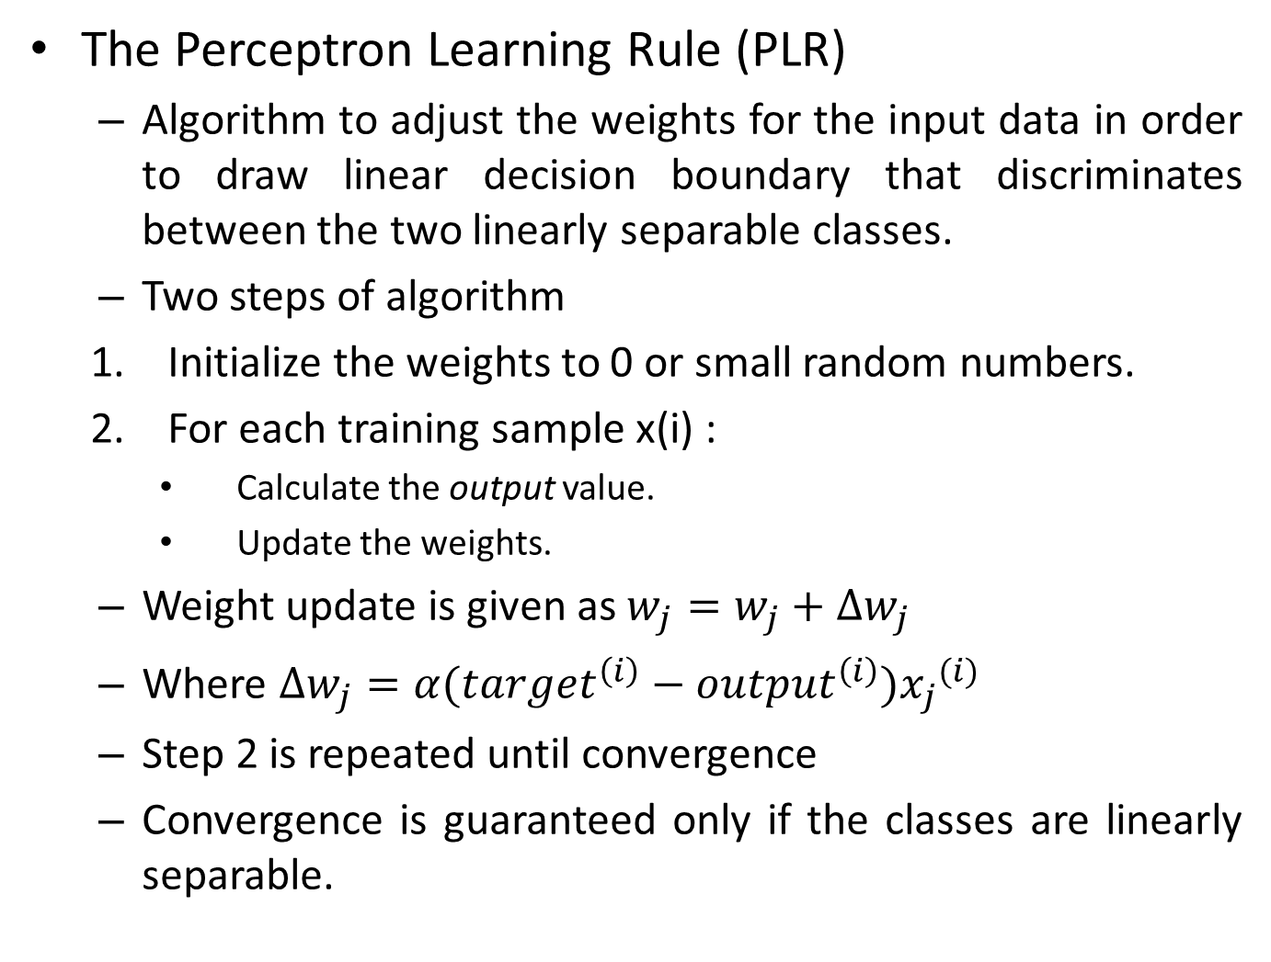
The Perceptron Learning Rule (PLR)
Algorithm to adjust the weights for the input data in order to draw linear decision boundary that discriminates between the two linearly separable classes.
Two steps of algorithm
Initialize the weights to 0 or small random numbers.
For each training sample x(i) :
Calculate the output value.
Update the weights.
Weight update is given as $w_{j}=w_{j}+∆w_{j}$
Where $∆w_{j}=α({target}^{\left(i\right)}−{output}^{\left(i\right)}){x_{j}}^{(i)}$
Step 2 is repeated until convergence
Convergence is guaranteed only if the classes are linearly separable.

Slide 12
For example, learn a Perceptron, function of logical AND gate.
X1=[0 0], x2=[0 1], x3=[1 0], x4=[1 1]
T=[0 0 0 1]
Let w=[0.2 0.3] and learning rate=0.1
Epoch 1:
W2 = w1+Δw
Δw = α (T1 – O1) x1
O1 = f(net1) = f((0.2)(0) + (0.3)(0)) = f(0) = 1
O1 ≠ T1
Δw = (0.1) (0 – 1) [0 0] = [0 0]
W2 = w1 = [0.2 0.3]
W3 = w2+Δw
Δw = α (T2 – O2) x2

Slide 13
O2 = f(net2) = f((0.2)(0) + (0.3)(1)) = f(0.3) = 1
O2 ≠ T2
Δw = (0.1) (0 – 1) [0 1] = -0.1 [0 1] = [0 -0.1]
W3 = w2 + Δw = [0.2 0.3] + [0 -0.1] = [0.2 0.2]
W4 = w3+Δw
Δw = α (T3 – O3) x3
O3 = f(net3) = f((0.2)(1) + (0.2)(0)) = f(0.2) = 1
O3 ≠ T3
Δw = (0.1) (0 – 1) [1 0] = -0.1 [1 0] = [-0.1 0]
W4 = w3 + Δw = [0.2 0.2] + [-0.1 0] = [0.1 0.2]
W5 = w4+Δw
Δw = α (T4 – O4) x4
O4 = f(net4) = f((0.1)(1) + (0.2)(1)) = f(0.3) = 1
O4 = T4
W5 = w4 = [0.1 0.2]

